Slide 1
Fuel System
Fuel Tank Project
PSG EDT

Slide 2
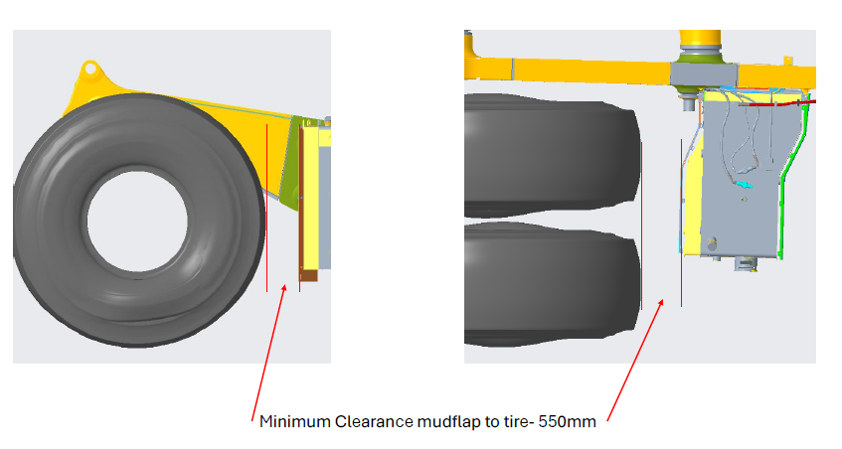
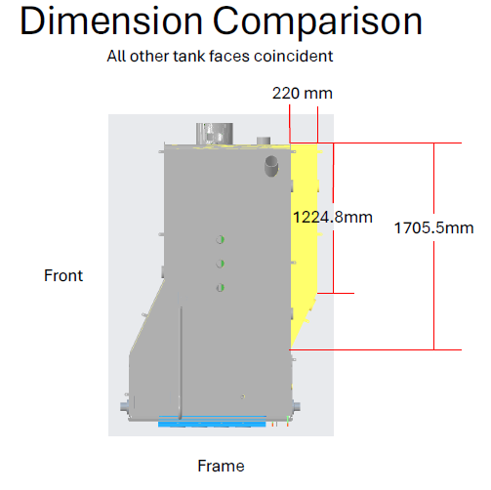
Fuel Tank Project – Proposal
Notes:
1585 galones

Slide 3
Fuel Tank Project – Proposal
Notes:
1585 galones

Slide 4
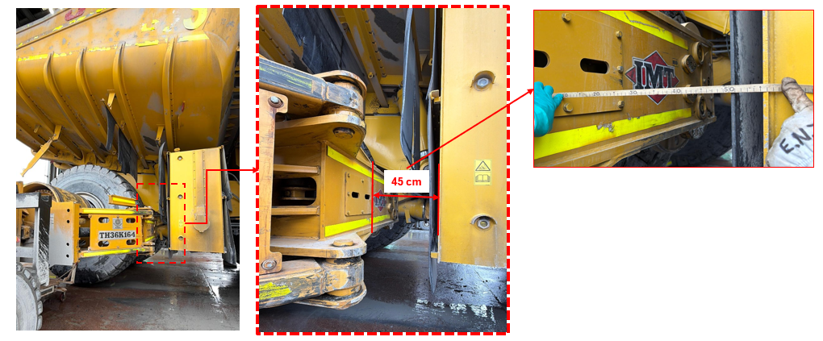
Fuel Tank Project – Inspection on Field ( Clearance without modification)

Slide 5
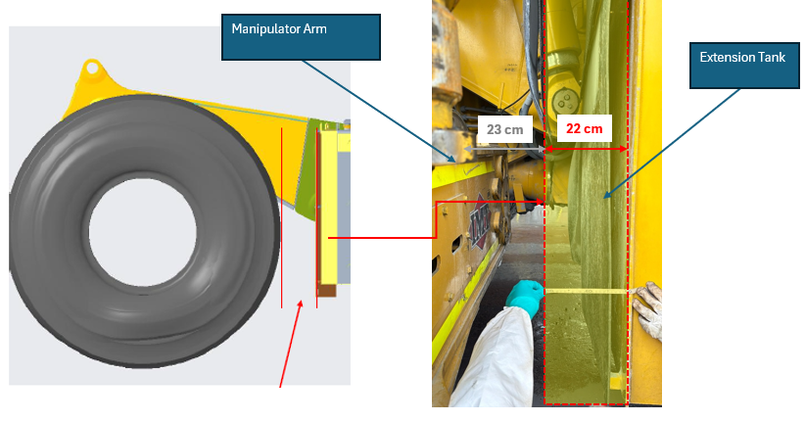
Fuel Tank Project – Inspection on Field(( Clearance with modification)

Slide 6
